Slide 1
MINI PROJECT
A Novel Image Encryption Scheme Based on a Modified AES
Algorithm
Ajay Dileep
Allwin Nebu
Alvin Boby Mathew
Mathew Somy
Guide : Asst.prof.Devina Vinod

Slide 2
CONTENT
Introduction.
Objective.
Special Features.
About the application.
Application working.
About MAES.
Why MAES?
How MAES?
Target users and Social relevance.
Gantt chart.
Conclusion and next phase.

Slide 3
INTRODUCTION
With the increasing need for data security, steganography has become a crucial technique for hiding sensitive information within digital media. The project aims to develop a application for doing steganography that integrates Modified AES encryption to securely embed text and audio files into a image. This combination of steganography and encryption help to improve the security of the application.

Slide 4
SPECIAL FEATURES
MAES is used instead of AES which is more safer and have avalanche effect.It is more suitable for image encryption.
For normal steganography application and software when we try to embed a audio file which is larger than the image file which you are going to hide the audio it won't embed since there are not enough pixels but here we expand the size of the image thus making it suitable for dividing the pixels according the audio size.

Slide 5
OBJECTIVE
To encrypt and embed sensitive text and audio files inside image using steganography.
To enhance security by implementing Modified AES encryption.
To provide a user friendly GUI-based system.
To provide data confidentiality.

Slide 6
ABOUT THE APPLICATION
Overview:
Hide text and audio files inside an image.
Use Modified AES.
Ensure confidentiality.
Uses python for development.

Slide 7
Working:
Encoding:
1.User select an image and a text/audio file.
2.The file is encrypted using MAES(128-bit key).
3.The encrypted data is embedded into the image using steganography.
4.A stego-image is generated.
Decoding:
1.User loads the steg-image.
2.The encrypted data is extracted from image and data is decrypted using MAES.
3.Original text/audio file is recovered.

Slide 8
ABOUT MAES
What is MAES?
It is advanced version of AES designed to improve security and efficiency, particularly for image encryption.
It modifies the key expansion process and encryption step to provide better resistance against attacks and faster performance.

Slide 9
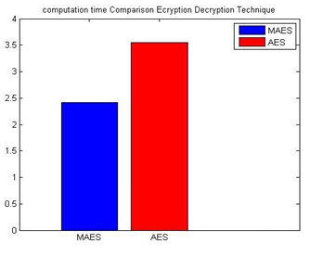
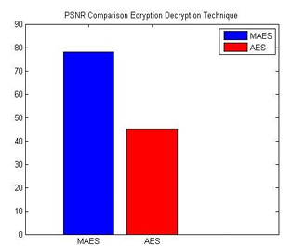
Why MAES?
AES have FIXED KEY schedule but MAES have dynamically CHANGING KEY.
AES have SINGLE XOR operation but MAES have TWO XOR operation.
AES is SLOWER (enc time : 34.112637 dec time : 4.460517) but MAES is FASTER (total time taken ....5.641608).
AES is LESS suitable for image encryption but MAES is MORE Suitable for image encryption

Slide 10
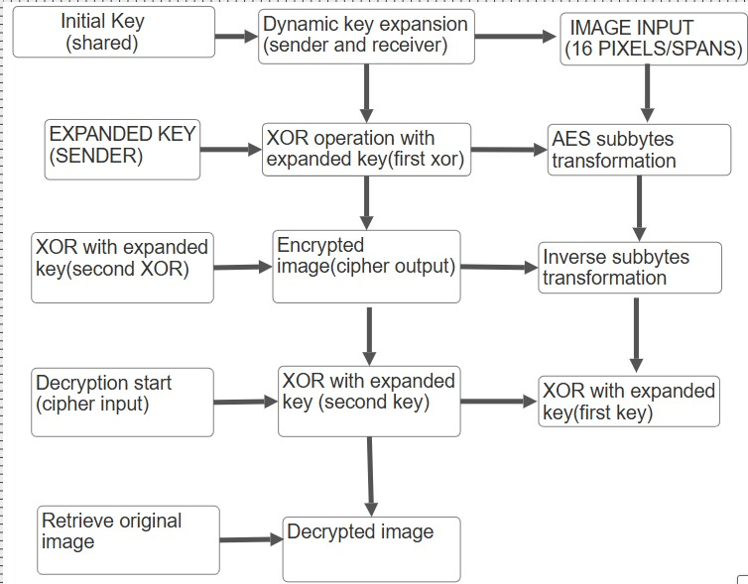
How it Works?
A 128 bit key is selected.
Multiple keys are generated.
Images are processed in 16 pixel block and did xor with expanded keys.
A non linear transformation (like AES S-Box) is applied.
Second XOR is done and encrypted image is generated.
For decryption inverse SubBytes transformation is applied.
XOR operation is reversed to get original pixel value thus original image is got.

Slide 11
TARGET USERS AND SOCIAL RELEVANCE
Target users: CyberSecurity Professional, Journalist and Activists, Government and Military, Legal Professionals, Students and Researchers.
Social relevance : Enhanced Privacy & Security (Helps protect sensitive data from hackers and unauthorized access), Secure Communication (Prevents cyber threats in personal and professional communications), Data Protection in Digital Age (Ensures confidential storage of critical information), Prevention of Cybercrime (Reduces risks of identity theft, data breaches, and surveillance), Ethical Hacking & Research (Aids in developing more advanced security measures).

Slide 12
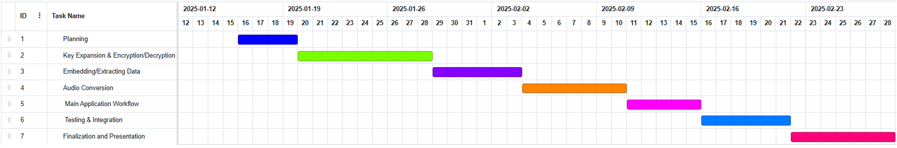
GANTT CHART
Time schedule of the project.

Slide 13
CONCLUSION AND NEXT PHASE
This steganography application integrates Modified AES encryption (MAES) with image steganography to provide a secure and efficient method for hiding and retrieving sensitive data. By encrypting the data before embedding, the system ensures high-level security against attacks. The user-friendly interface makes it accessible for various use cases, ensuring confidentiality and data integrity in secure communication.
At Next phase we start development and testing will also be done along with development.

